Slide 1
Major Assignment (Topic: amazon)
Group 3: Neron Parmar Jashanpreet Singh
Sanam Lakhotra Priyanka

Slide 2
CONTENTS:
Vision and Values
Product and services
CULTURE
CLIENTS & IMPACTS
SUCCESS STORY OF AMAZON
Publicity Methods Currently Used by Amazon
NETWORKING AND SOCIAL MEDIA TOOLS FOR AMAZON’S OUTREACH
INTERVIEW QUESTIONS

Slide 3

Vision and Values
Amazon is guided by four principles: customer obsession rather than competitor focus, passion for invention, commitment to operational excellence, and long-term thinking.
Amazon strives to be Earth’s most customer-centric company, Earth’s best employer, and Earth’s safest place to work.
Customer reviews, 1-Click shopping, personalized recommendations, Prime, Fulfillment by Amazon, AWS, Kindle Direct Publishing, Kindle, Career Choice, Fire tablets, Fire TV, Amazon Echo, Alexa, Just Walk Out technology, Amazon Studios, and The Climate Pledge are some of the things pioneered by Amazon.

Slide 4

Product and services
Every day, we invent on behalf of our customers, partners, and communities.
Our vision is ambient intelligence, which uses artificial intelligence (AI) to weave together devices and services in a way that offers more value than any one product could on its own—at home or on the go.
Our customers inspire us, and they’ve been at the heart of how we invent and evolve our products.

Slide 5
CULTURE
Amazon's commitment to diversity, equity, and inclusion (DEI) is deeply embedded in its corporate culture and operations.
Guided by its 16 Leadership Principles, Amazon prioritizes diverse perspectives, learning, and trust-building.
Leaders actively create a safer, more diverse, and inclusive work environment while leading with empathy and fostering fun.
The company's vision is to be Earth's best employer and incorporates DEI into its efforts to build inclusive teams.
Amazon invests in communities, supports underrepresented entrepreneurs, and offers skills training.

Slide 6
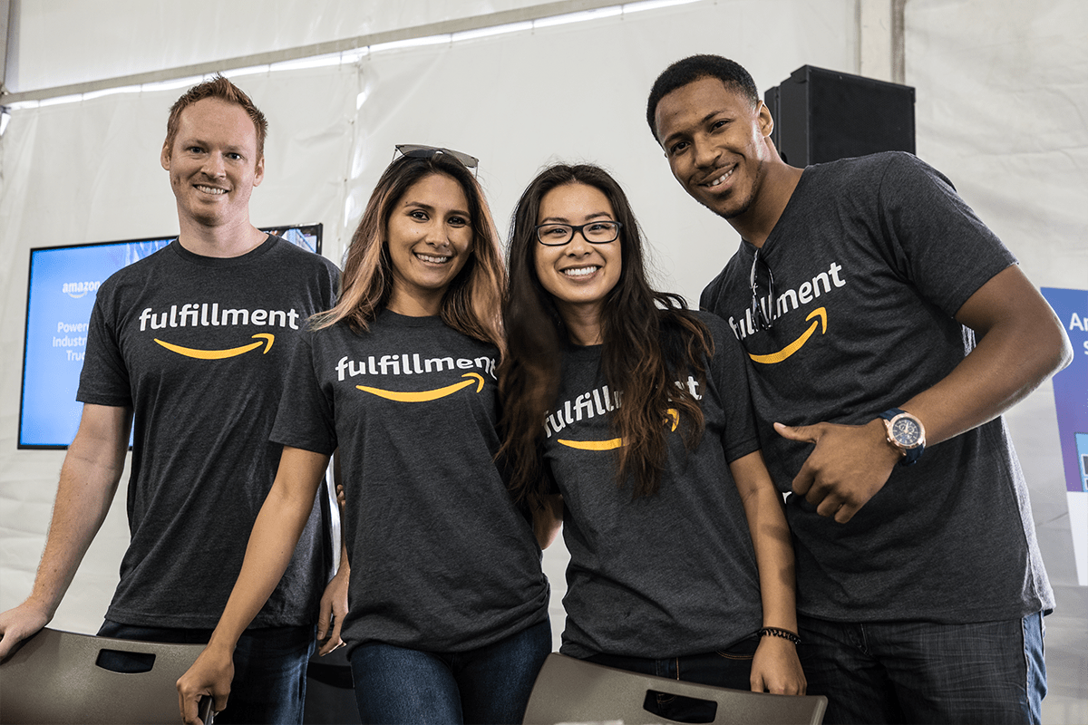
CULTURE
It also emphasizes developing diverse leaders and mentorship programs to increase representation.
Affinity groups celebrate inclusivity, and the company actively promotes gender equity, supports Indigenous communities, and engages with the LGBTQIA+ community.
Amazon is dedicated to improving accessibility, supporting veterans and military families, and leveraging AI to accelerate progress.
These efforts have earned Amazon recognition and awards for its commitment to advancing DEI globally.

Slide 7


CLIENTS & IMPACTS
Clients:
Millions of individual customers worldwide.
Sellers and businesses using Amazon's platform.
AWS clients including startups and enterprises.
Impact:
Enabling small businesses to reach a global audience.
Shaping e-commerce and online services.
Environmental initiatives like The Climate Pledge.

Slide 8
REFERENCES:
Amazon Devices & Services (aboutamazon.com)

Slide 9

SUCCESS STORY OF AMAZON:
Amazon is founded by jeff Bezos as an online store in 1994 after quitting his job to focus on his initial idea.
Later in the late 1900s and early 2000s, growing to become a major internet retailer platform in North America and Europe.
gradually expanded its business Worldwide and the introduction of Amazon Web services expanded the scope of its services to include cloud computing, revolutionary online shopping.

Slide 10
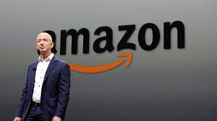
SUCCESS STORY OF AMAZON: Key factors that contributed to Amazon's remarkable success include:
Diverse Offerings: Starting as an online bookstore, Amazon expanded its product offerings to include DVDs, CDs, and a wide range of other products, catering to various markets and verticals.
Amazon Web Services (AWS): The introduction of AWS allowed Amazon to provide cloud computing and services to various sectors globally, further diversifying its business.
Focus on Efficiency: Amazon's continuous efforts to improve its business operations and enhance efficiency contributed to its growth and success.
Commitment to Promises: Amazon's consistent delivery on its promises, from low prices to reliable shipping, built trust among customers.
Early Internet Adoption: Amazon capitalized on the power of the internet, establishing a strong online presence early on, which became a significant advantage.
Customer-Centric Approach: Amazon's focus on providing an exceptional customer experience, with features like simple and seamless interfaces, customization options, and fast shipping, helped build customer loyalty.
Innovation and Adaptability: Amazon's willingness to innovate, experiment with new ideas, and enhance the customer experience led to the introduction of services like Amazon Prime and technologies like Alexa.

Slide 11
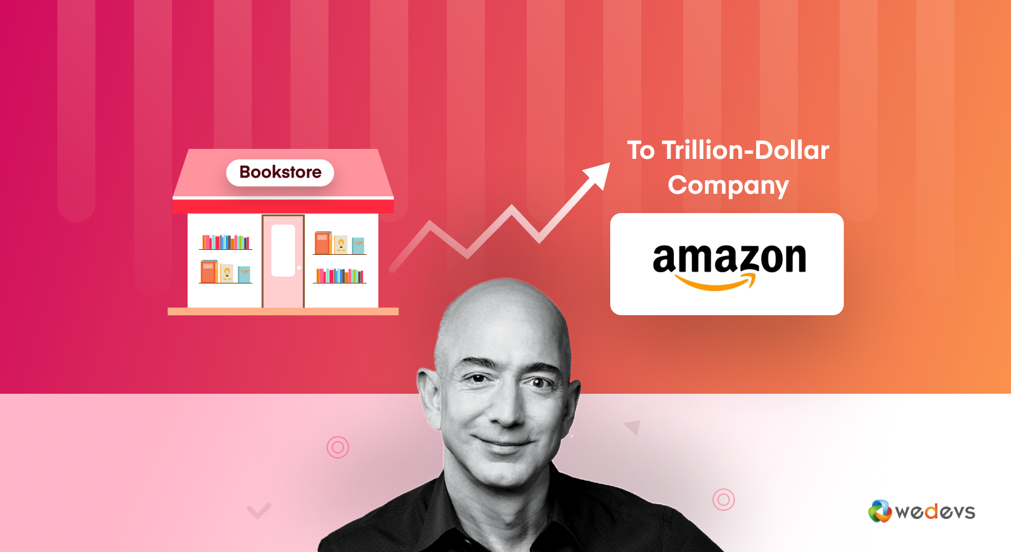
SUCCESS STORY OF AMAZON:
Amazon's journey to becoming a trillion-dollar eCommerce empire can be attributed to a strategic blend of customer-centric focus, a vast product range, cutting-edge technology, exceptional customer support, rapid delivery, innovative sales strategies, competitive pricing, global reach, consumer safety assurance, Kindle publishing, and a talented user experience (UX) team.
Reference:
https://wedevs.com/amp/blog/413420/amazon-success-story/

Slide 12
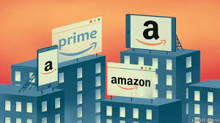
Publicity Methods Currently Used by Amazon:
Diverse Product Range:
Amazon sells a wide variety of products across different categories, ranging from electronics and clothing to home appliances and more.
The diverse product range attracts a broad customer base, promoting Amazon's brand as a one-stop shopping destination.
Competitive Pricing Strategy:
Amazon employs a competitive pricing strategy by analyzing its competitors' prices and adjusting its own prices accordingly.
This approach helps Amazon attract price-conscious consumers and maintain a competitive edge in the market.

Slide 13
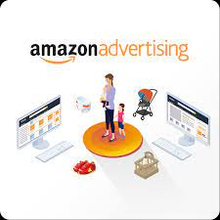
Publicity Methods Currently Used by Amazon:
Global Reach and Accessibility:
Amazon's online platform is accessible in over 200 countries, allowing customers worldwide to access a vast selection of products.
Efficient shipping and fulfillment hubs contribute to Amazon's global success, making it possible to deliver products quickly to even remote areas.
Multichannel Marketing and Advertising:
Amazon employs a variety of advertising channels to reach its target audience, including websites, newspapers, TV, billboards, and social media platforms.
Regular ads, sales, discounts, and affiliate partnerships contribute to building the Amazon brand and driving sales.

Slide 14
Publicity Methods Currently Used by Amazon:
PPC Advertising on Amazon:
Amazon utilizes various forms of pay-per-click (PPC) advertising on its platform, including headline search ads, product display ads, and sponsored product ads.
These ads enhance product visibility, drive traffic, and promote sales for sellers and brands.
Strong Social Media Presence:
Amazon leverages popular social media platforms such as Facebook, Instagram, Twitter, YouTube, and Pinterest to promote products and engage with customers.
Each platform is used strategically to share company news, advertisements, contests, and valuable content.

Slide 15
Publicity Methods Currently Used by Amazon:
Amazon's YouTube Strategy:
Amazon creates attention-grabbing and valuable YouTube ads that make viewers feel special.
This approach helps Amazon stand out and ensures its ads resonate with the audience.
Influencer Collaborations:
Amazon collaborates with both big and small influencers to reach a wider audience effectively.
Influencers from diverse backgrounds contribute to Amazon's marketing campaigns, enhancing brand visibility and credibility.

Slide 16
Reference:
https://www.simplilearn.com/tutorials/marketing-case-studies-tutorial/amazon-marketing-strategy#:~:text=It%20uses%20a%20lot%20of,social%20media%2C%20among%20other%20places.

Slide 17

Networking and Social Media Tools for Amazon's Outreach:
Facebook:
Facebook is a widely used social media platform with over 2.8 billion monthly active users.
Benefit for Amazon:
Massive User Base: With over 28.7 million likes on its Facebook page, Amazon can tap into a vast audience for brand promotion and engagement.
Customer Interaction: Amazon can actively engage with customers by quickly responding to comments, addressing concerns, and providing helpful information, creating a positive brand image.
Personalization: Amazon can personalize interactions by addressing commenters by their first names, adding a human touch to its responses.
Promotions and Coupons: Amazon can use Facebook to highlight products, offer date-related coupons, and share discounts, driving sales during specific occasions like holidays or special events.
Product Reviews: Leverage the social aspect of Facebook by showcasing product reviews written by users' Facebook connections, adding authenticity to recommendations.

Slide 18
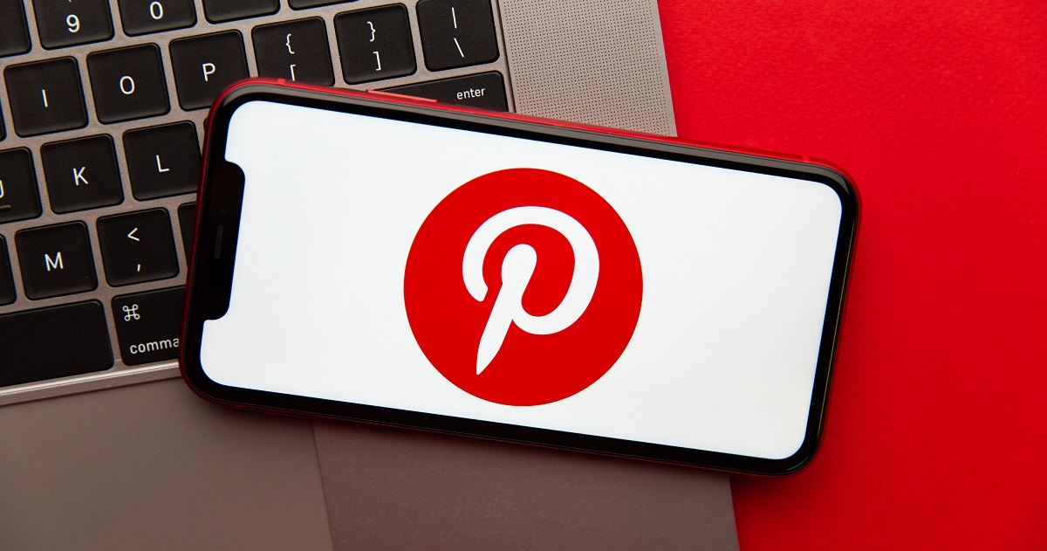
Networking and Social Media Tools for Amazon's Outreach:
Pinterest:
Pinterest is a visual discovery platform with engaged users seeking inspiration and ideas.
Benefit for Amazon:
Visual Discovery: Amazon can create appealing Pins featuring its products, attracting users searching for purchase ideas and driving them directly to Amazon's platform.
Direct Purchase: When users find a Pin from Amazon, they can click through to purchase the product directly or complete the purchase through Amazon, streamlining the buying process.
Niche Marketing: Pinterest's user base leans towards specific interests, allowing Amazon to target niche audiences based on their preferences.
Promotion of Bespoke Lines: Amazon can use Pinterest to promote specialized lines such as Handmade at Amazon or Amazon Style for Women, directing users to explore these offerings.
Inspiration for Users: By curating content related to lifestyle areas, Amazon can inspire users and showcase products within the context of their interests.

Slide 19

Networking and Social Media Tools for Amazon's Outreach:
Amazon Spark (Amazon's Own Social Network):
Amazon Spark is an integrated social network within the Amazon app focused on shopping engagement.
Benefit for Amazon:
Direct Shopping Integration: Spark enables users to discover products within the app and make purchases directly, enhancing the shopping experience.
Engagement and Data Generation: Spark generates engagement through comments, recommendations, and likes, providing valuable insights into user preferences.
Community Building: Spark fosters a sense of community where users discuss products and interests, allowing Amazon to nurture brand loyalty.
Targeted Advertising: Spark's data on user interests and aspirations can inform targeted ad campaigns, ensuring personalized recommendations for users.
Innovative Engagement: Amazon can utilize Spark to experiment with innovative ways of engaging users and creating a more interactive shopping environment.

Slide 20
Reference:
https://etaileast.wbresearch.com/blog/amazons-engaged-buyers-drive-social-media-revenue

Slide 21

INTERVIEW QUESTIONS:
Can you provide an overview of Amazon's core communication strategies and how they align with the
company’s overall mission and values?
Answer: Amazon's communication strategies are centered around customer obsession, innovation, and long-term thinking. We aim to provide clear and concise messaging across all customer touchpoints, focusing on building trust and delivering on our promises.
2. How does Amazon approach customer communication across various channels, such as social media, email, and website interfaces?
Answer: Our approach to customer communication is to ensure consistency while adapting to each platform's unique requirements. We aim to personalize our messages and make them relevant to individual customers, fostering engagement and satisfaction.
3. Can you share an example of how Amazon has effectively handled a communication crisis in the past and the strategies employed to mitigate potential damage?
Answer: During the widespread shipping delays last year, we communicated openly with customers about the challenges we were facing. We provided timely updates on the situation, offered solutions, and demonstrated our commitment to resolving issues. This transparency helped us maintain customer trust.

Slide 22

INTERVIEW QUESTIONS:
4. With Amazon's global presence, how do you tailor communication strategies to resonate with diverse cultures and regions?
Answer: We recognize the importance of cultural sensitivity. Our communication strategies are adaptable, taking into account local customs, languages, and preferences. We collaborate with regional teams to ensure our messages resonate authentically with customers around the world.
5. Amazon is known for its innovation. How do you incorporate innovative approaches into your communication strategies to keep customers engaged and interested?
Answer: Innovation is at the heart of what we do. We continually explore new communication platforms and technologies to deliver fresh, engaging experiences. For instance, our use of AI-driven chatbots has transformed customer interactions, providing quicker and more personalized support.
6. How does Amazon maintain a consistent brand voice and messaging while catering to diverse audiences and product categories?
Answer: Our brand voice is grounded in our core principles, such as customer-centricity and reliability. While adapting to different audiences, we maintain these foundational elements to create a recognizable and cohesive brand identity.

Slide 23

INTERVIEW QUESTIONS:
7. Could you share insights into how Amazon collects and utilizes customer feedback to enhance its communication strategies and overall customer experience?
Answer: Customer feedback is invaluable. We use data analytics to gather insights from customer interactions, reviews, and surveys. This data informs our communication improvements and helps us address pain points effectively.
8. In what ways does Amazon leverage data analytics and metrics to measure the effectiveness of its communication strategies?
Answer: We employ a range of metrics, such as engagement rates, customer feedback scores, and conversion rates, to assess the impact of our communication efforts. This data-driven approach allows us to refine strategies and optimize results
Reference –
Gallo, C. (2021, February 11). How Jeff Bezos Consistently Communicates Four Core Values That Made Amazon A Success. Forbes. https://www.forbes.com/sites/carminegallo/2021/02/11/how-jeff-bezos-consistently-communicates-four-core-values-that-made-amazon-a-success/

Slide 24

THANK YOU…
HOPE YOU ALL HAVE ENJOYED OUR PRESENTATION. HAVE A GOOD DAY EVERYONE…

